Slide 1

OUR VISION, YOUR HEALTH
Together with you in illness and wellness

Slide 2
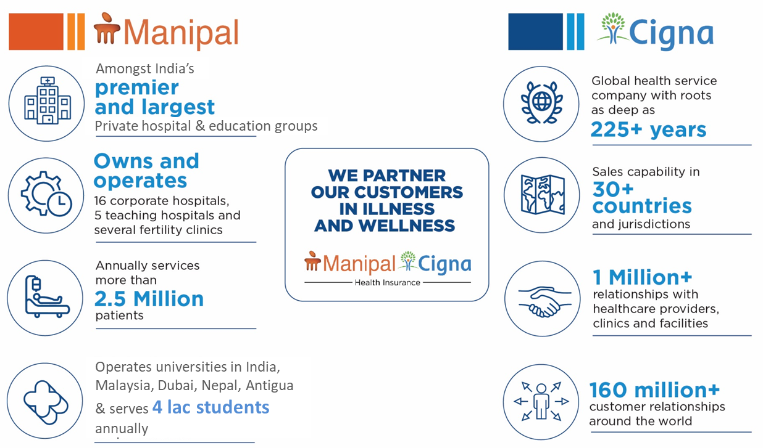

Leaders in Healthcare Financing & Healthcare Delivery coming together…
Health Insurance Expert with Global Experience and Local Expertise
India’s leading education and healthcare group in the country with 7+ decades of legacy
Owns and operates 49 patient friendly hospitals, serving over 8 Million patients annually
Acquired Columbia Asia, Vikram Hospitals, AMRI Hospitals
Now present in 24 cities with 12,600+ hospital beds and 11,000+ doctors
Global health service company with roots as deep as 230+ years
Ranked 13th on the 2025 Fortune 500 List
182 Million+ customers relationships and 2 Million+ global relationships with healthcare providers , clinics & facilities
Global workforce of 72,000 + employees who serve customers around the globe
Key Highlights
Key Highlights

Slide 3
Who We Are
Our Mission
Who We Are
Our Role
To improve the health and vitality of those we serve
We are a trusted health insurance expert for the community we serve
To be champions for our customers and our communities
3

Slide 4
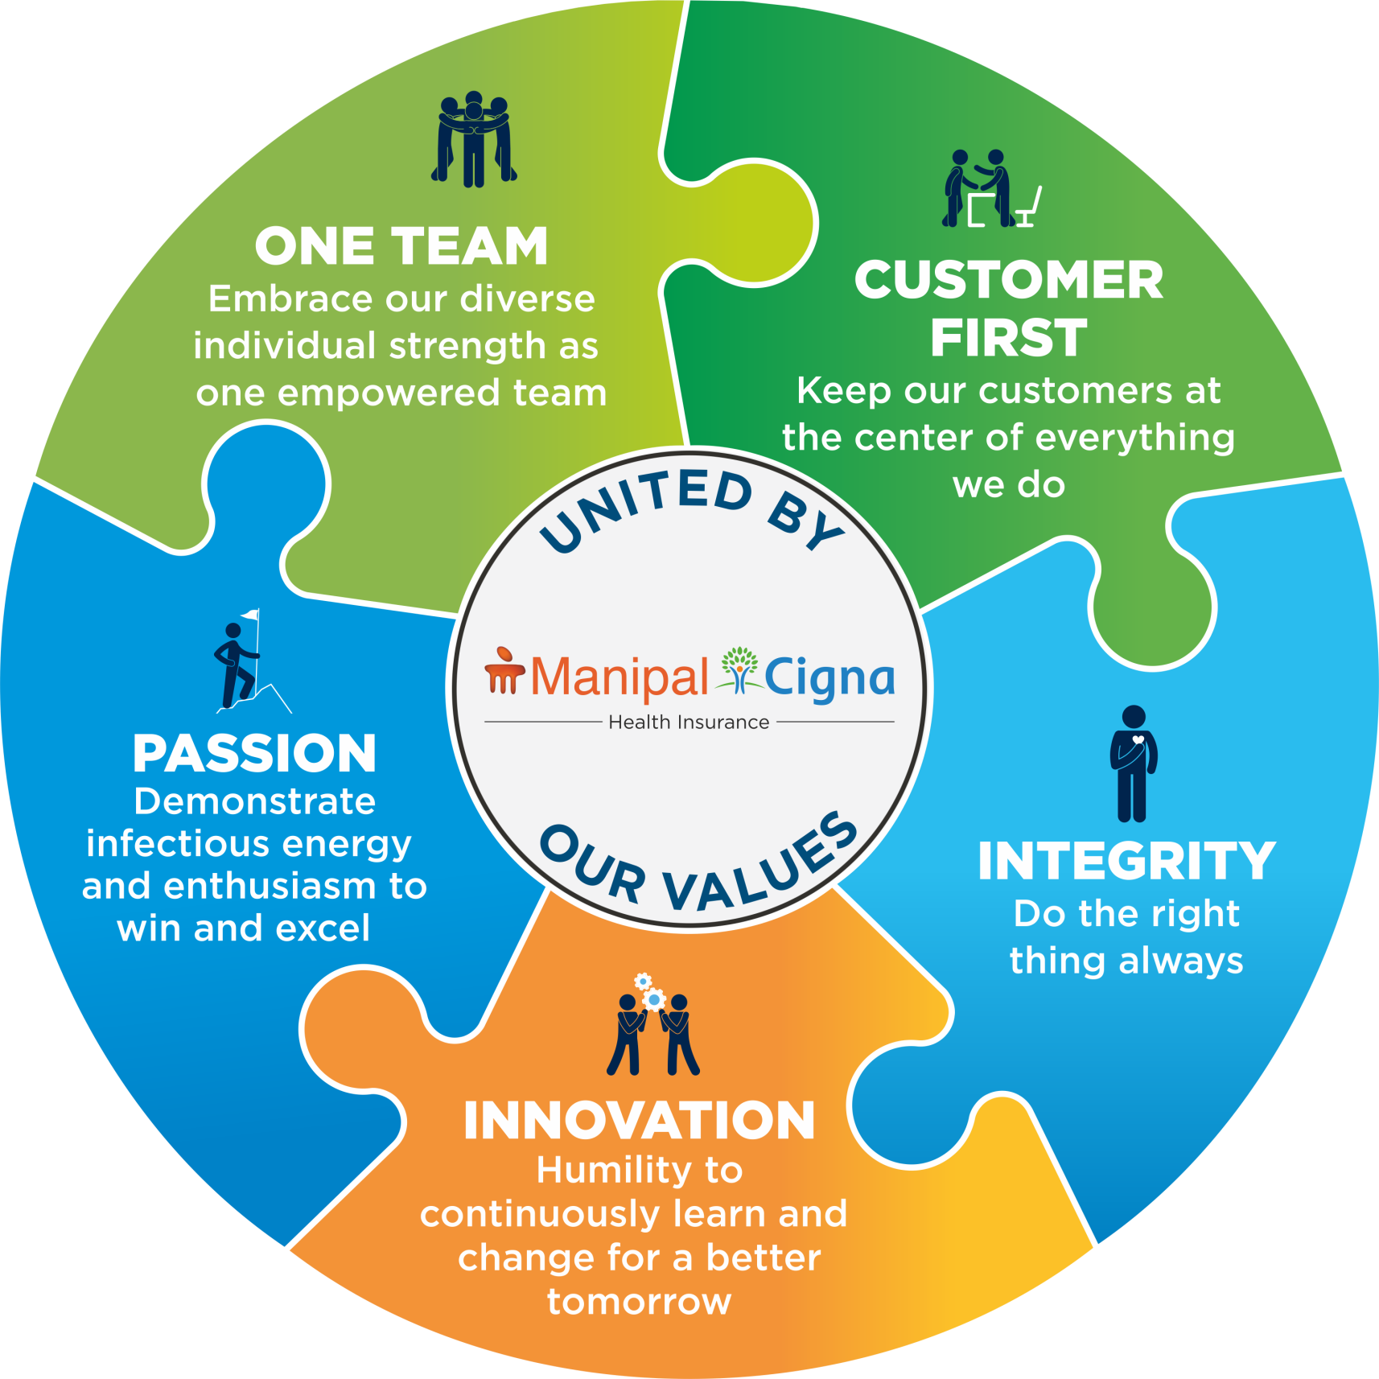
Our Values
TOGETHER, WE ARE
UNITED BY OUR VALUES
Our values support our mission and represent who we are
and what we want to aspire to be.
4

Slide 5








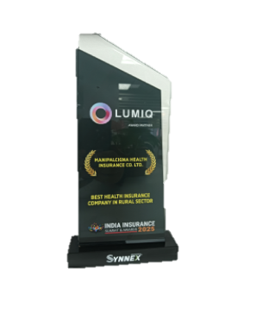


2024-25 Industry recognition for our Differentiated Approach
PRODUCT
SERVICE
BRAND/CAMPAIGN
TECH
PEOPLE
ManipalCigna Sarvah Voted Product of the Year
Best Customer Centric Company - Customer Fest
Best Use of Digital Channels – Mere Choice ka Health Insurance Campaign​
Certified as a Great Place to Work
Digital Experience Strategy of the year - UBS Forums ​
Product Innovation Company Of The Year - Synnex Business
Customer Experience Team of the Year - UBS
Best Health Insurance Company In Rural Sector- Synnex Business
Best Initiative in Digital Customer Experience & Engagement award
Top 5 Best Workplaces in General Insurance & Health Insurance
5

Slide 6
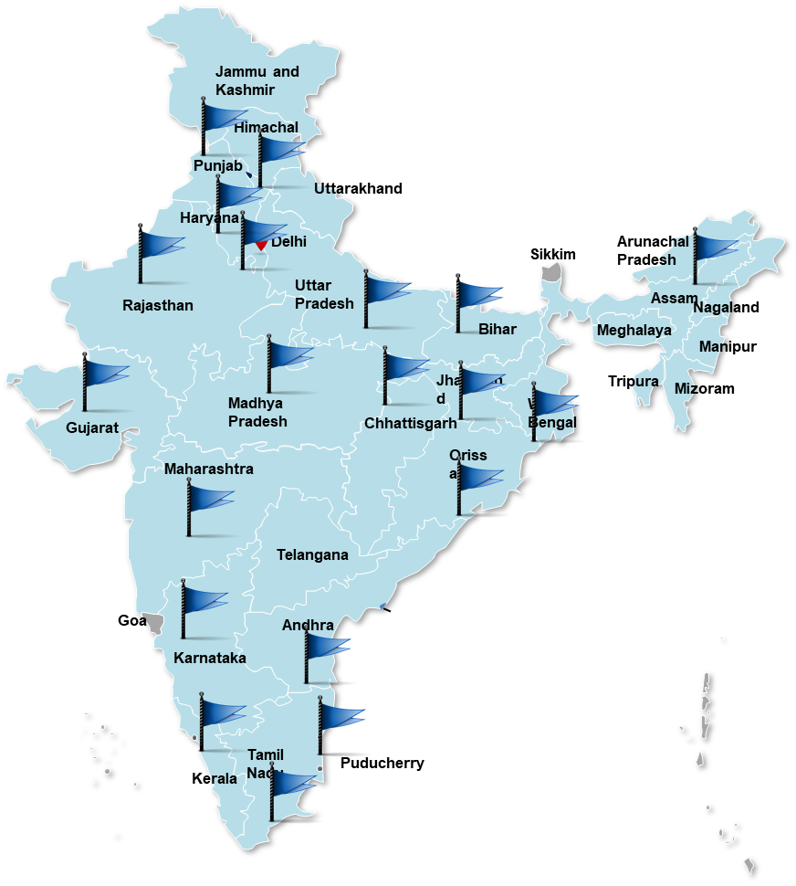
Our Journey so far
BUSINESS GROWTH
Launched Operations in 2014
MCHI has achieved ~₹2000 Cr GWP in FY2024-25
ACTIVE LIVES
15.5 Million+
DISTRIBUTION
Building a Multi-Channel Distribution
Geographic Expansion 100+ branches.
Present in 400+ cities with Branches & Residential Managers
Agents 90,000+
Manpower 3,000+
PRODUCT PORTFOLIO
Multi Product addressing different segments of TG including global cashless
CUSTOMER EXPERIENCE
Strong process and experience
14,000+ hospital network
Introduced mobile app ‘myManipalCigna’ & ‘Chatbot
Confidential, unpublished property of ManipalCigna Health Insurance Co. Ltd. Do not duplicate or distribute. Use and distribution limited solely to authorized personnel. © 2019 ManipalCigna Health Insurance Co. Ltd.
6

Slide 7

Our Strategy
OUR COMBINATION WITH MANIPAL GROUP ACCELERATES OUR STRATEGY
To deliver on our promise to provide easy and lifetime access to quality healthcare so that our customers have a secure future both financially and medically
+
Together, we
Drive | Expand | Provide
Innovative solutions products and services | Existing relationships and explore new markets | Easy and lifetime access to quality healthcare
7

Slide 8
How We Will Win
1
Be an Undisputed Partner of Choice
Affordability
2
Make the Complex Simple
Personalization
Customer Value
The measure that matters
3
Adopt World Class Technology
Superior
Customer Experience
4
Inspired & Motivated
Best in Class People
8

Slide 9





Our Strategy aligned with Key Needs
Customers
Healthcare
Professionals
Regulator
Personalized, affordable
solutions to touch upon all
segments
Expanded access and
improved affordability
Value-based partnering
and care delivery
Employer and
Health plan Clients
Communities
Greater affordability
and productivity
Improved health,
vitality and productivity
9

Slide 10

We are your partner in illness and wellness
We provide easy and lifetime access to quality healthcare
We safeguard your
long term financial goals
We help you live a
healthier life
As your partner in health, we collaborate with our vast network of healthcare professionals to ensure all our customers obtain quality, cost-effective health care, benefits and insurance protection.
As health advocates, we offer a full suite of health insurance products that shields long-term finances from being drained out in case of medical emergencies, so that our customers have a secure future – both financially and medically.
As a health insurance company, our involvement with our customers goes deeper than handling insurance claims. We support customers through our various wellness programs to stay healthy or return to health if they become physically or emotionally ill.
10

Slide 11





We are Champions for our Customers and our Communities
Innovation
We leverage deep consumer insights to drive product innovation
Rich Experience
We make the complex simpler to improve the customer experience
Comprehensive Plans
We offer easy to understand, affordable products designed to meet the unique needs of the customers across all segments
Health & Wellness
We offer a variety of wellness programs and services to help customer live healthier, fuller lives
Customer Centricity
We make experiences easy and reliable—in ways that our customers find proactive, personal and empathetic.
11

Slide 12
Get started on a Healthier You with our Products & Services
OUR PRODUCT PHILOSOPHY
With a deep focus on health and wellness, at ManipalCigna Health Insurance we offer a full suite of insurance solutions ranging from health, personal accident, major illness, travel and global care to individual customers, employer-employee, and non-employer-employee groups to meet their diverse health needs.
12

Slide 13
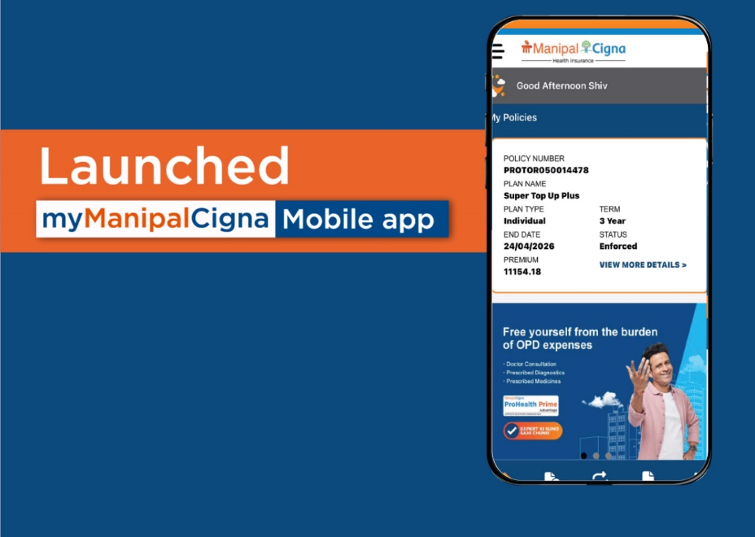
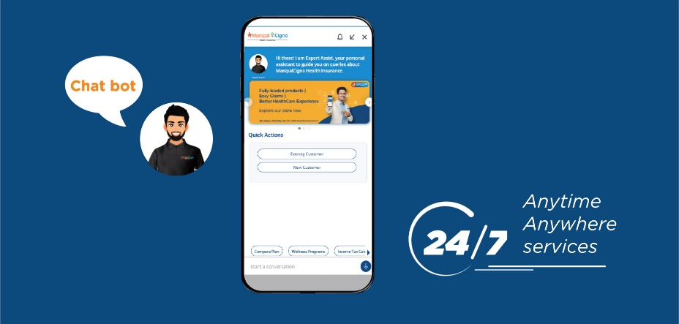
Our Digitally Empowered Partners and Customers
Today 100% of our customer on-boarding across all segments is digital without any paperwork
Our newly launched mobile app and chat bot enables our existing customers to avail our services 24/7 and anytime, anywhere

Slide 14
Expertise that’s Global, Care that’s Indian at Heart
OUR SERVICE PHILOSOPHY
  Everyday we make experiences easy and reliable in ways that our customers find proactive, personal and empathetic.
Confidential, unpublished property of ManipalCigna Health Insurance Co. Ltd. Do not duplicate or distribute. Use and distribution limited solely to authorized personnel. © 2019 ManipalCigna Health Insurance Co. Ltd.
14

Slide 15
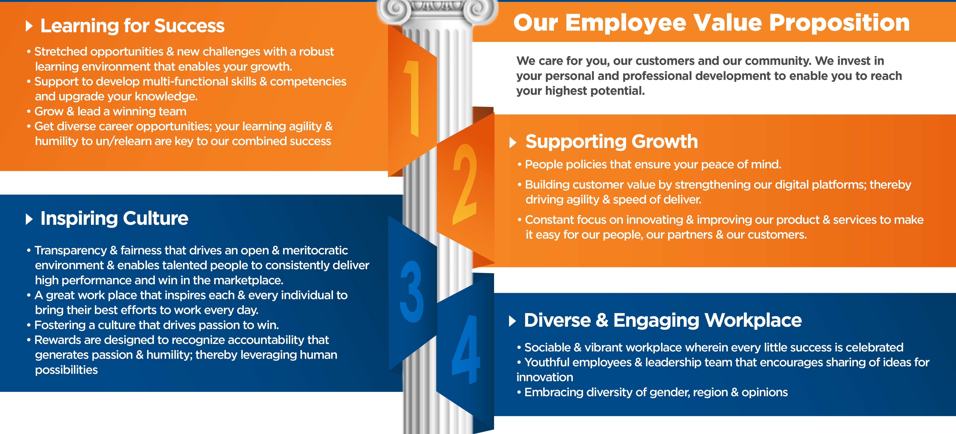
We Care – Our People Commitment
15

Slide 16
What matters most to us?
R
I
G
H
T
Right Product
Right Sale
Right Partners
Right Service
Right Experience
Offering the right product to the right segment to address the unique health insurance needs
Acquiring new customers the right way
Building long lasting partnerships with strategic partners
Delivering our promise and exceptional customer service across touch points
Focus on delighting customers by providing value-added services
16

Slide 17

THANK YOU

